Slide 1

Category Code: C5
Problem Statement Title: InvestWise AI: Intelligent Wealth Creation Platform (Investment & Stock Market Insights )
Team Name: EPIC BYTES
Institute Name: Vivekanand Education Society’s Institute of Technology

Slide 2

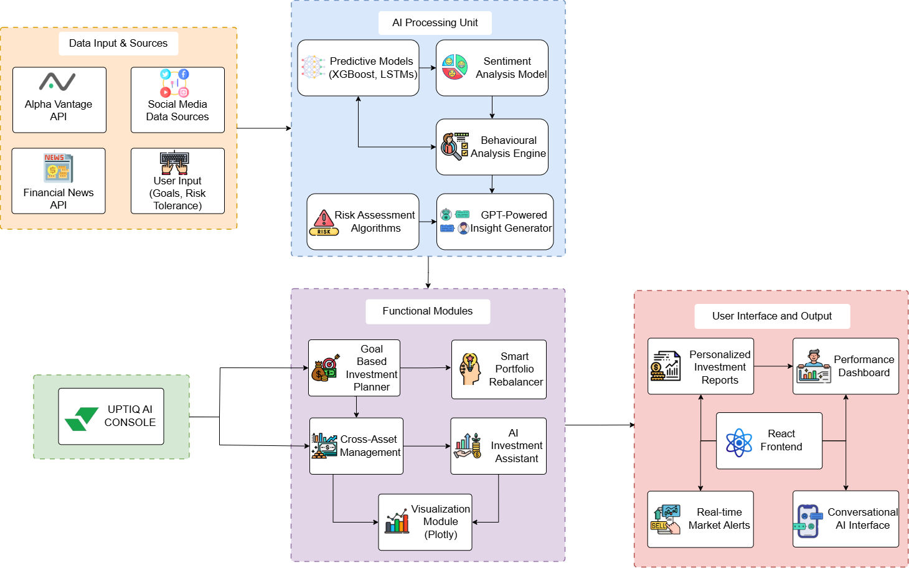
Idea / Approach details (& implemented features)
Uptiq Implementation Link:
Link

Slide 3
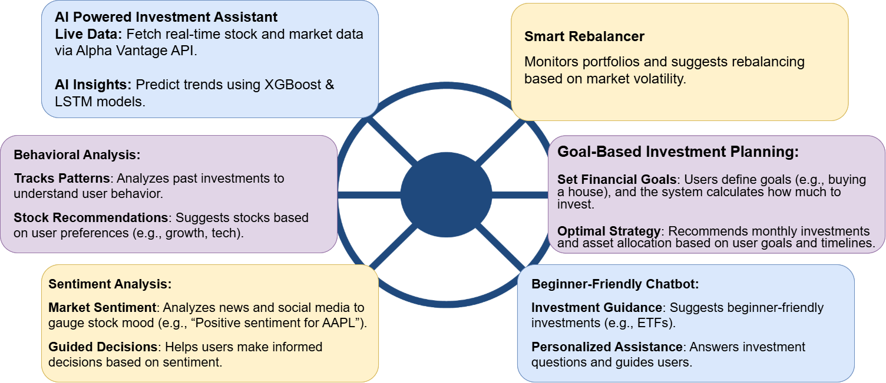
Innovation (Showstopper)

Slide 4
Innovation (Showstopper)
Real-Time Stock Insights Using UPTIQ AI:
Data Collection:
Use UPTIQ's Market Data API to fetch real-time stock data, including historical prices, market indices, sectors, and individual stock data. You can set up API calls to retrieve:
Stock prices
Market indices
Sector performance
Historical price data for trend analysis
Model Deployment (XGBoost & LSTM):
UPTIQ’s Model Hub: You can deploy predictive models such as XGBoost and LSTM (Long Short-Term Memory) using UPTIQ’s Model Hub.
XGBoost will be used to analyze historical stock data and identify potential trends and patterns.
LSTM is ideal for time-series forecasting, predicting stock price movements over time.

Slide 5
Innovation (Showstopper)
Goal-Based Investment Planning Using UPTIQ AI:
Financial Goal Setting:
User Input: Users specify their financial goal (e.g., buying a house, saving for retirement), target amount (e.g., $200,000), and timeline (e.g., 10 years).
UPTIQ AI: Collect and store user inputs using Input and Question actions in UPTIQ.
Predictive Model for Optimal Investment Strategy:
Model Deployment: Use UPTIQ’s Model Hub to deploy models like XGBoost and LSTM for analyzing market data and calculating the best strategy.
XGBoost: Analyzes past stock performance and suggests asset allocation.
LSTM: Predicts potential returns using time-series forecasting.
Calculation: Models calculate the required monthly investment (e.g., “Invest $600/month in a diversified portfolio with 8% expected return over 8 years”).
Providing Recommendations:
Output: UPTIQ generates an optimal investment plan, displayed to the user.
Example: “To reach your $200,000 goal in 10 years, invest $600/month in a balanced portfolio with 8% expected return.”

Slide 6
Innovation (Showstopper)
Sentiment Analysis Using UPTIQ AI:
Market Sentiment Analysis:
User Input: Users specify the stock or asset they are interested in (e.g., "AAPL" or "S&P 500").
UPTIQ AI: Use RAG Query or Vector Search to retrieve relevant financial news, social media posts, and analyst opinions.
Sentiment Evaluation:
NLP Model: Use BERT or RoBERTa models deployed on UPTIQ’s Model Hub to analyze the sentiment of the gathered data (e.g., positive, neutral, or negative sentiment around a stock).
Analysis: Sentiment score is calculated based on the aggregated news and social media data. It helps understand the mood around a stock, such as “positive sentiment for AAPL.”
User Output:
Display: UPTIQ uses Display action to present the sentiment analysis result to the user, providing actionable insights like “Positive sentiment for AAPL due to strong earnings” or “Negative sentiment for TSLA due to market volatility.”

Slide 7
Innovation (Showstopper)
Sentiment Analysis Using UPTIQ AI (RAG-Enhanced):
Market Sentiment Analysis:
User Input: Users specify the stock or asset they want insights on (e.g., “AAPL” or “S&P 500”).
UPTIQ AI: Retrieval-Augmented Generation (RAG): Uses Vector Search to fetch relevant financial news, social media posts, and analyst opinions from the MongoDB vector store indexed with OpenAI’s text-embedding-3-large model.
LLM-Enhanced Insights: GPT-3.5 Turbo (Azure) generates contextualized responses based on the retrieved data.
Sentiment Evaluation:
A sentiment score is calculated by aggregating news, social media data, and expert opinions.
Example: “Positive sentiment for AAPL due to strong earnings” or “Negative sentiment for TSLA due to market volatility.”
User Output:
Display Action: Sentiment analysis results are presented with key insights, supported by retrieved evidence via RAG for transparency.

Slide 8
Innovation (Showstopper)
Behavioral Analysis Using UPTIQ AI:
User Behavior Tracking:
User Input: Users input their investment preferences, past investments, and risk tolerance (e.g., "I prefer growth stocks" or "I’ve invested in tech stocks").
UPTIQ AI: Use Input actions to capture this data and store it for behavioral analysis.
Clustering for Personalized Recommendations:
Clustering Algorithm: Use K-Means or DBSCAN clustering algorithms deployed on UPTIQ’s Model Hub to segment users based on their past investment patterns and risk tolerance.
Analysis: The system identifies patterns like "high-risk tolerance, growth stock preference" or "low-risk tolerance, stable dividend stocks preference."
Stock Recommendations:
Personalized Recommendations: Based on the clusters, UPTIQ provides personalized stock recommendations. For example, for a user with high risk tolerance, the system might suggest "Consider investing in TSLA or NVDA."
Output: Use the Display action to show the recommendations, guiding users to investment opportunities that align with their behavior and preferences.

Slide 9
Innovation (Showstopper)
Smart Rebalancer Using UPTIQ AI:
User Portfolio Input:
User Input: Users provide their current portfolio details (assets, risk tolerance, and preferences).
UPTIQ AI: Use Input actions to collect and store this data for rebalancing analysis.
Market Data Collection:
Data Collection: Use UPTIQ’s Market Data API to fetch real-time data on stocks, bonds, and other assets in the portfolio.
Risk & Performance Metrics: Retrieve key metrics like asset performance and market volatility.
Portfolio Monitoring and Prediction:
AI Models: Use LSTM and XGBoost deployed on UPTIQ’s Model Hub to predict market trends and forecast future asset performance.
Risk Assessment: Calculate portfolio risk (e.g., Value-at-Risk) based on market conditions.
Rebalancing Suggestions:
Optimization Logic: Based on predictions, UPTIQ AI calculates the optimal portfolio adjustments (e.g., increase bonds, reduce tech stocks).
Proactive Advice: Recommend actions like “Increase bond allocation by 5%” during market volatility.
Displaying Recommendations:
User Output: Use UPTIQ’s Display action to show rebalancing recommendations and visualizations (e.g., pie charts of portfolio allocations).

Slide 10
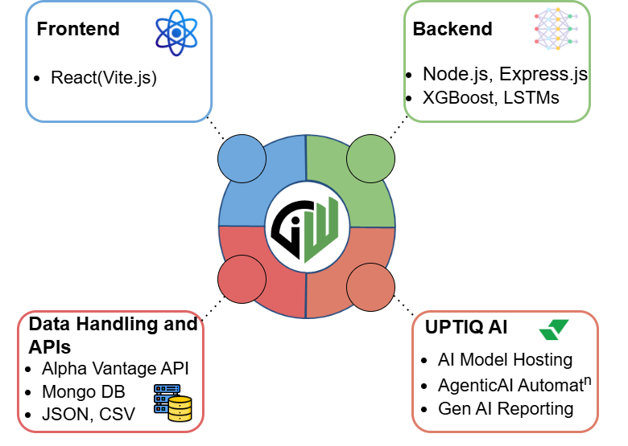
Tech Stack

Slide 11
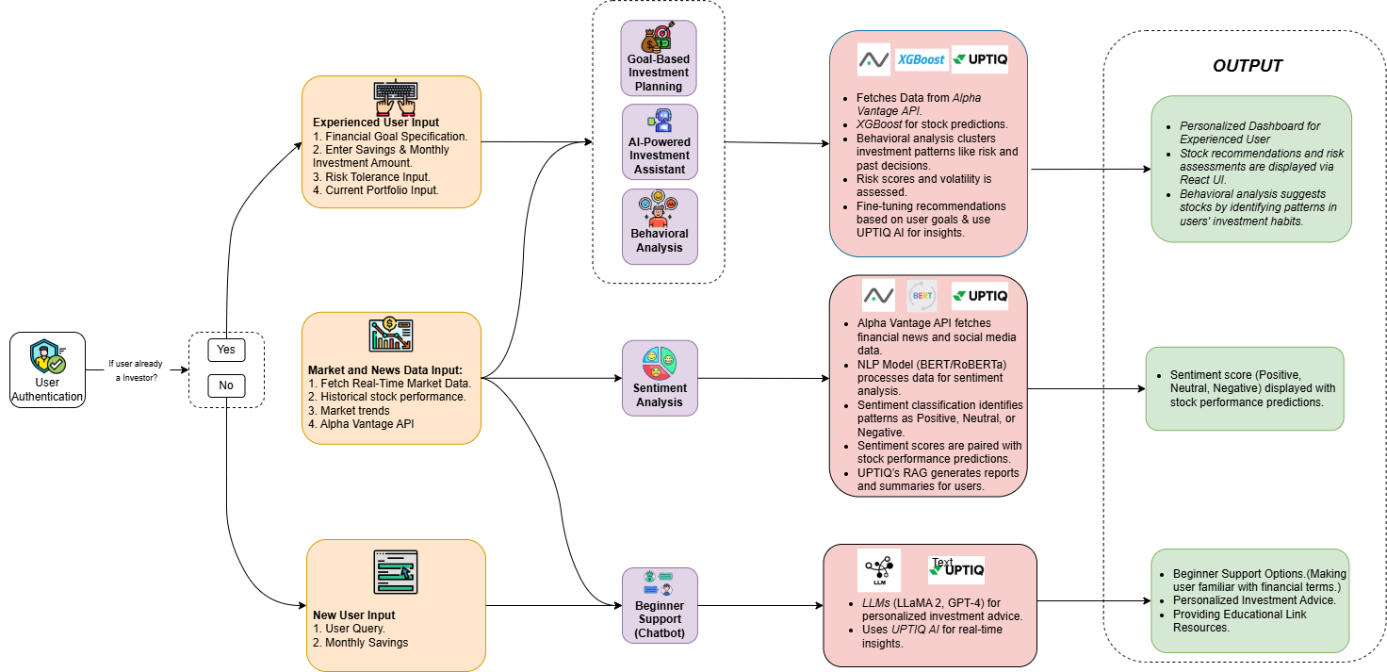
Implementation/Prototype/Use Case Diagram (screenshots)

Slide 12
Implementation of Sentiment Analysis
Steps
Created a API key in NewsAPI.
Ran a Python Code and got a JSON file which we then converted to CSV due to some incompatibility issues.
Then we created Data sources after that created vector store and after that we made a RAG Container.
We choose the LLM model as GPT-3.5 Turbo Azure.
Then the model was working fine with the queries it was tried on.

Slide 13
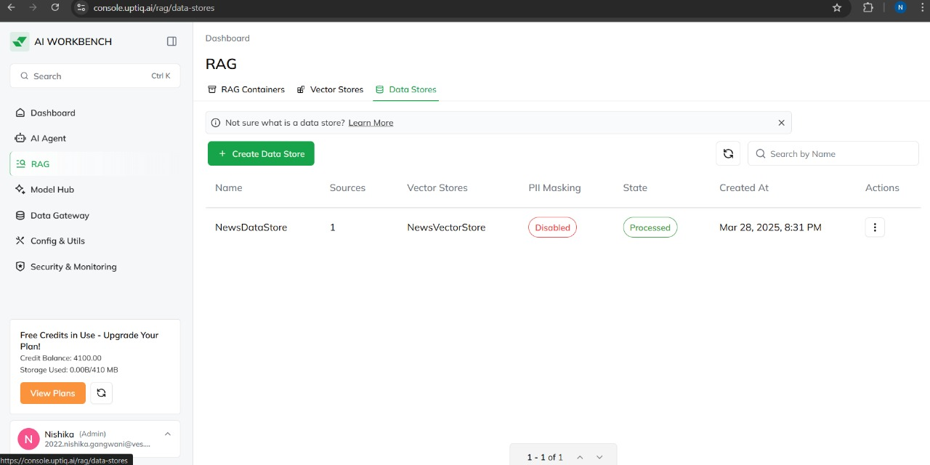
Implementation of Sentiment Analysis

Slide 14

Implementation of Sentiment Analysis

Slide 15
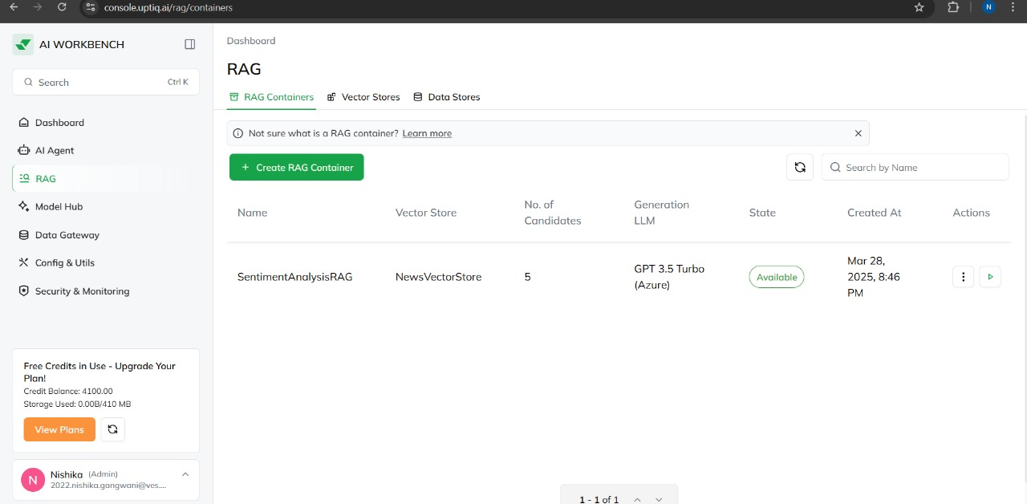
Implementation of Sentiment Analysis

Slide 16
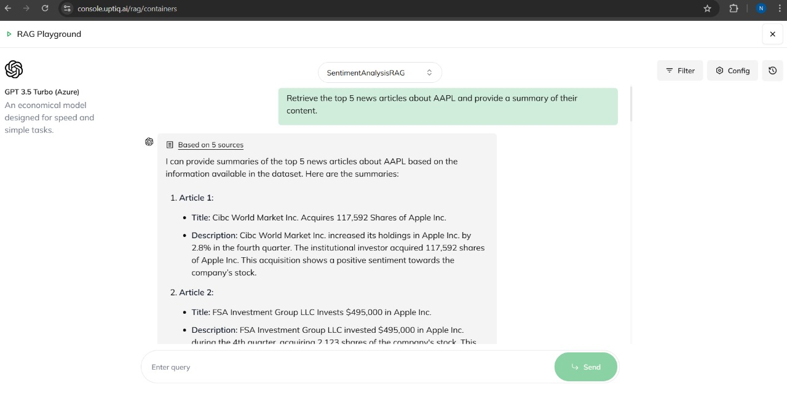
Implementation of Sentiment Analysis

Slide 17
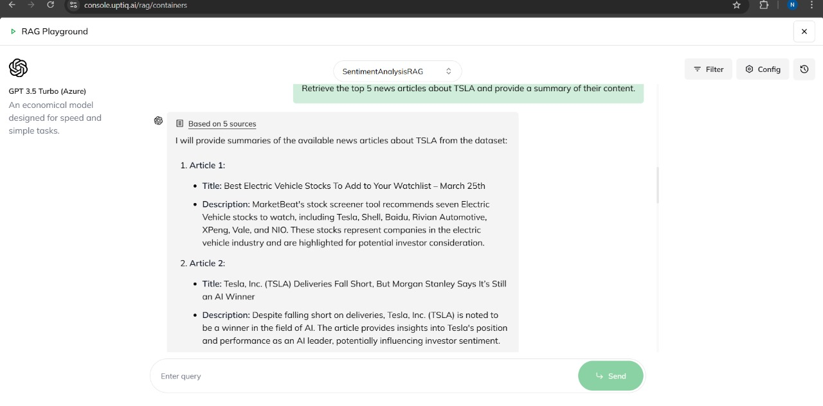
Implementation of Sentiment Analysis

Slide 18
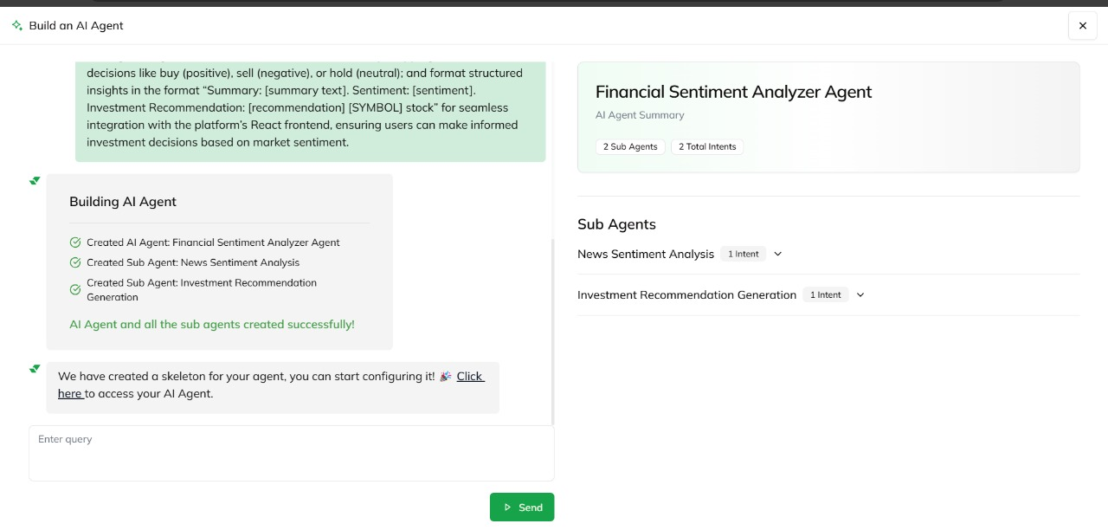
Implementation of Sentiment Analysis

Slide 19
Implementation of Sentiment Analysis

Slide 20
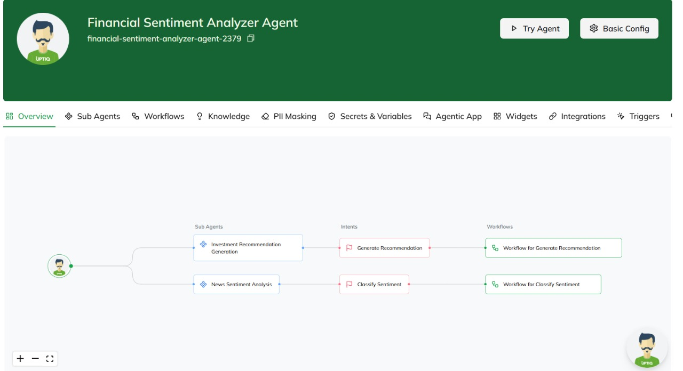
Implementation of Sentiment Analysis

Slide 21
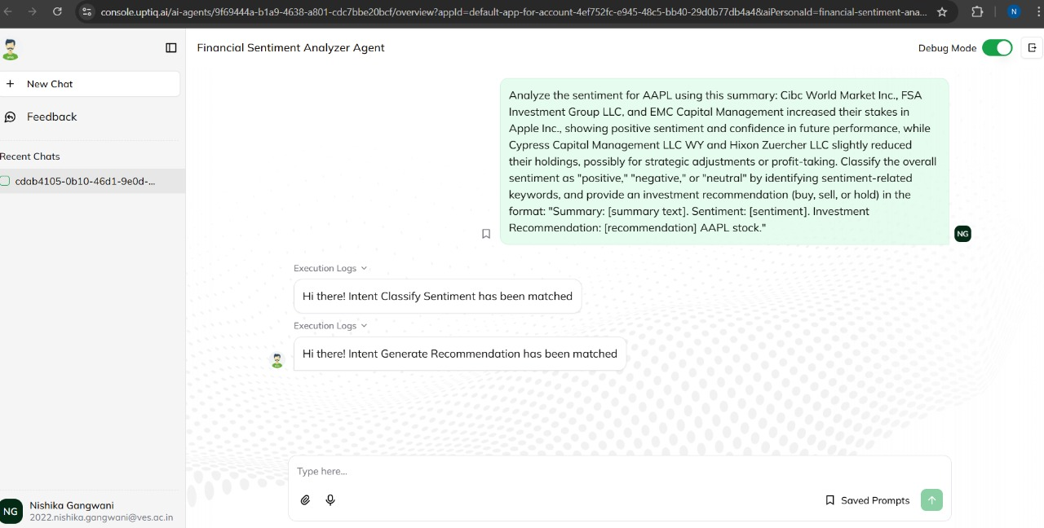
Implementation of Sentiment Analysis

Slide 22
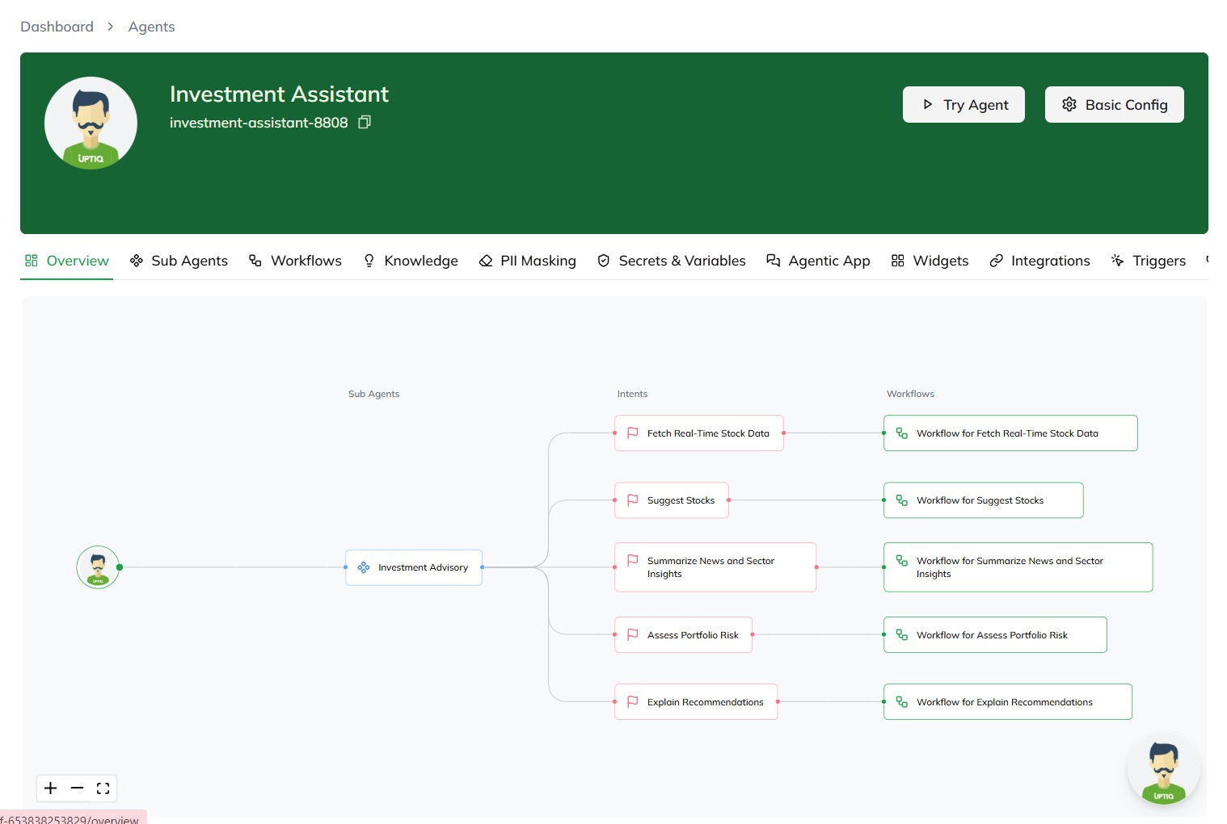
Implementation of AI Powered Investment Analysis

Slide 23
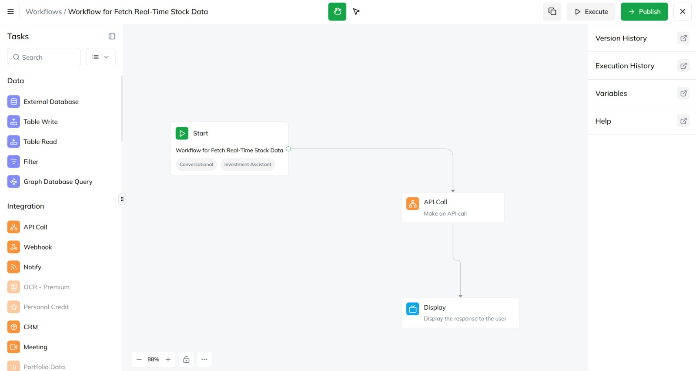
Implementation of AI Powered Investment Analysis

Slide 24
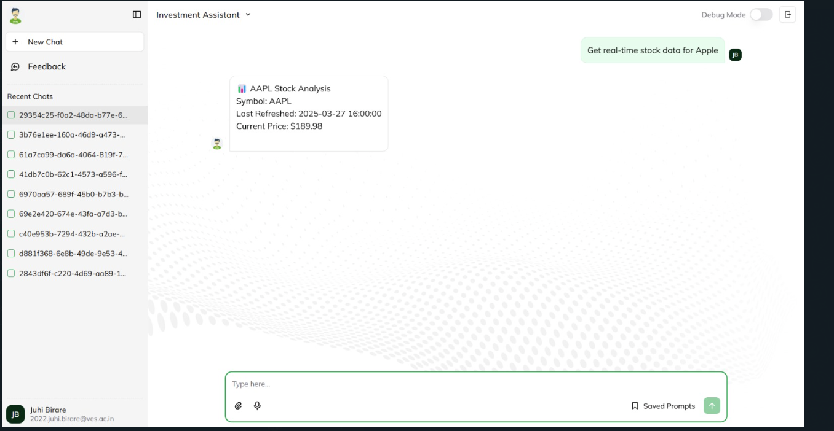
Implementation of AI Powered Investment Analysis

Slide 25
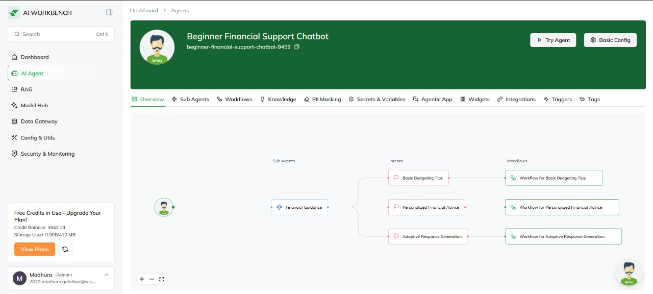
Implementation of Beginner Support ChatBot

Slide 26
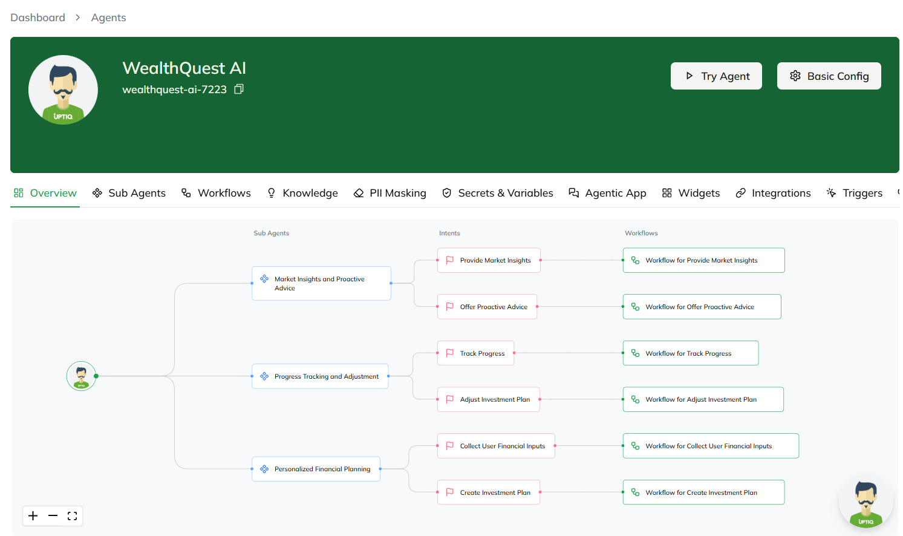
Implementation of Goal Based investment Planning

Slide 27
In case of Uptiq category - Your Uptiq Agent (explain in detail)
UPTIQ Platform Features
Sentiment Analysis
Scans financial news and social media with BERT/RoBERTa.
Tracks trends, updates sentiment, and suggests stocks using UPTIQ Agentic AI.
Goal-Based Planning
Accesses market data via Model Hub.
Creates financial plans (e.g., $500/month for a $100k house).
Offers guidance using UPTIQ RAG Model.
Smart Rebalancer
Assesses market volatility with LSTMs.
Adjusts assets (e.g., reduce tech by 5%).
Ensures trust using UPTIQ Agentic AI.
Behavioral Analysis
Evaluates trading habits and updates clusters with K-Means.
Recommends stock picks (e.g., TSLA) via UPTIQ Agentic AI.
Investment Assistant
Gathers data via Alpha Vantage/XGBoost.
Customizes stock recommendations and adds market context.
Provides insights using UPTIQ RAG Model.
UPTIQ RAG Model Features
Personalized Summaries
Generate daily/weekly portfolio performance reports.
Provide contextual market insights.
Adapt reports based on user preferences.
Beginner Support Chatbot
Deploy conversational AI using LLMs.
Provide guided financial advice.
Generate adaptive responses based on user queries.

Slide 28
Future Objectives
Expand Data Sources Globally Integrate international market data using APIs like Quandl and FRED for diversified insights.
Enhance AI Model Accuracy Improve prediction reliability with explainable AI using advanced models like XGBoost and LSTMs.
Support Diverse Asset Classes Enable investments in cryptocurrencies, REITs, and commodities for comprehensive portfolio management.
Hyper-Personalize User Experience Offer AI-driven dashboards tailored to individual goals and risk profiles, adding gamified challenges for engagement.
Implement Real-Time Stress Testing Simulate market shocks and economic scenarios to provide proactive risk management strategies.
Introduce AI-Driven Tax Optimization Analyze gains using tax data APIs and recommend tax-efficient strategies to maximize user savings.

